Slide 1

CODE FIRST GIRLS
INTRODUCTION TO DATA & SQL
Aveen Melling
March 2023

Slide 2
USE CASE
Create a database to manage the internal audit plan of a FTSE100 company, including:
Audit teams, managers and individual team members
Executive management sponsors and key stakeholders
Audit plan including key milestones, status and final grade for each audit
Capture the results of post-audit feedback questionnaires
Enable production of management information (MI) and reporting on timescales, team performance, stakeholder interaction and other factors

Slide 3
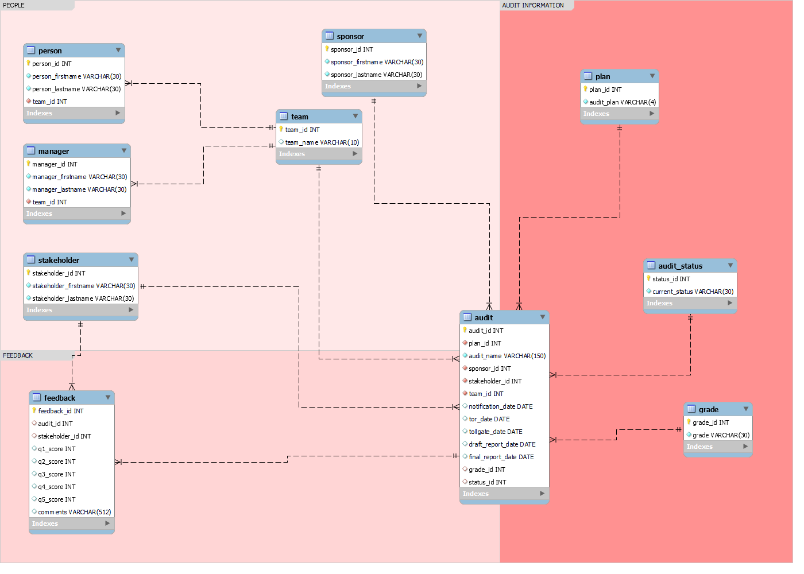
SCHEMA
10 tables in total including 2 fact tables (‘audit’ and ‘feedback’)
Normalised to 3NF to minimise redundancy
Primary keys set to auto increment

Slide 4
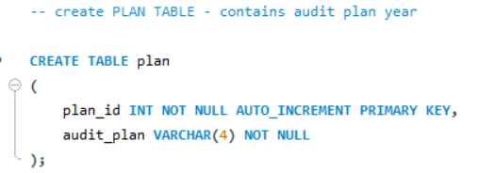
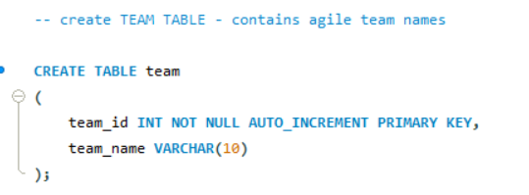
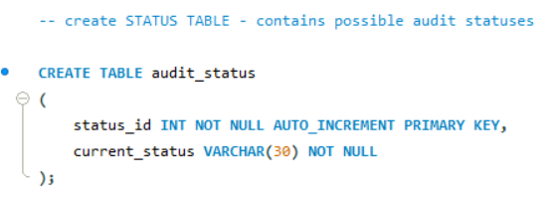
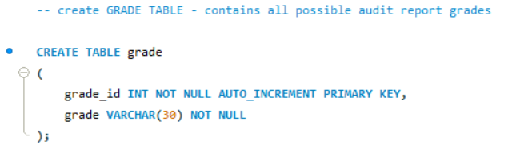
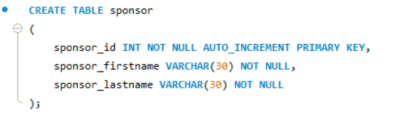
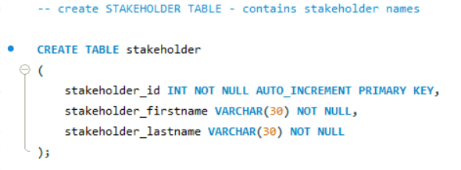
Creating DIMENSION TABLES with
PRIMARY KEYS

Slide 5
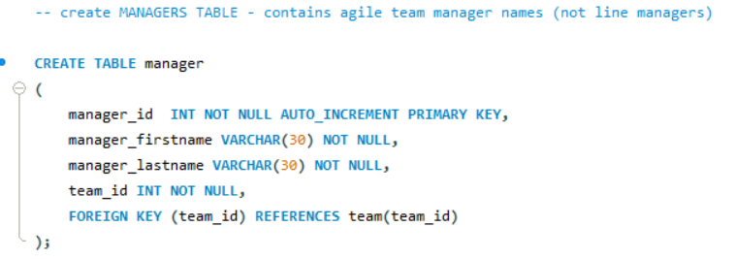
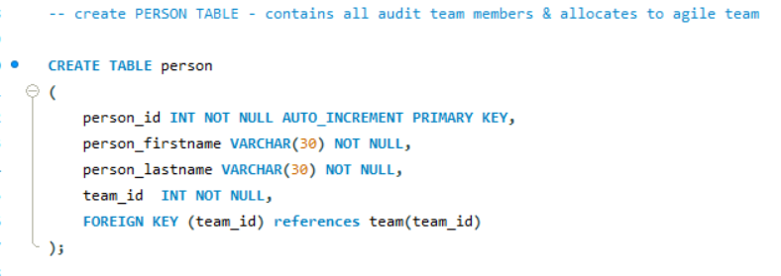
Creating DIMENSION TABLES with
PRIMARY and FOREIGN KEYS

Slide 6
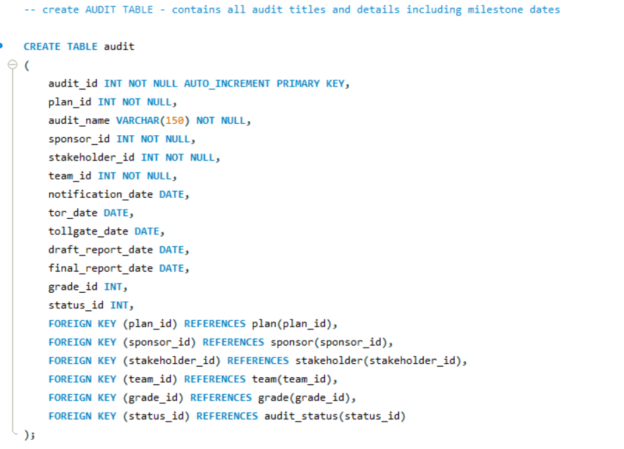
Creating ‘audit’ FACT TABLE with
PRIMARY and FOREIGN KEYS

Slide 7
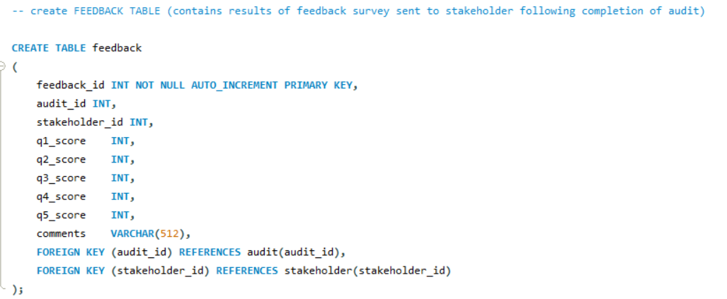
Creating ‘feedback’ FACT TABLE with
PRIMARY and FOREIGN KEYS

Slide 8
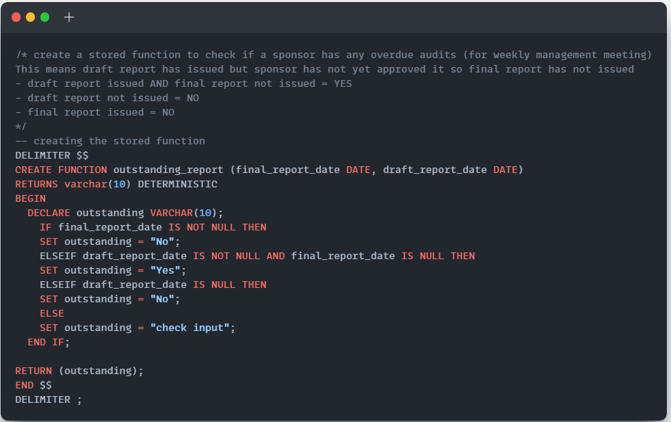
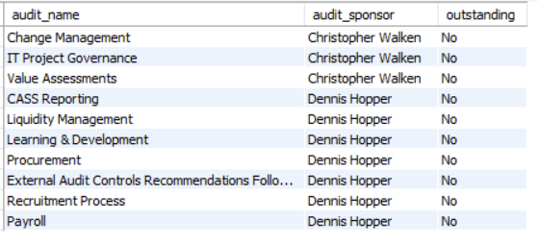
Creating a STORED FUNCTION to identify any overdue audits

Slide 9
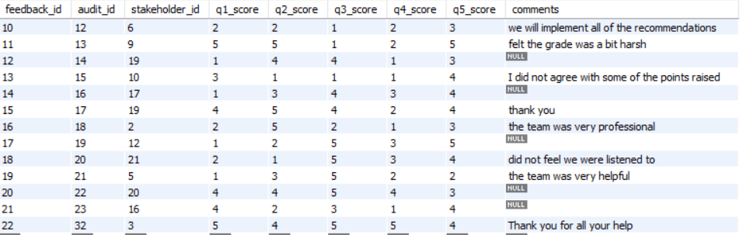
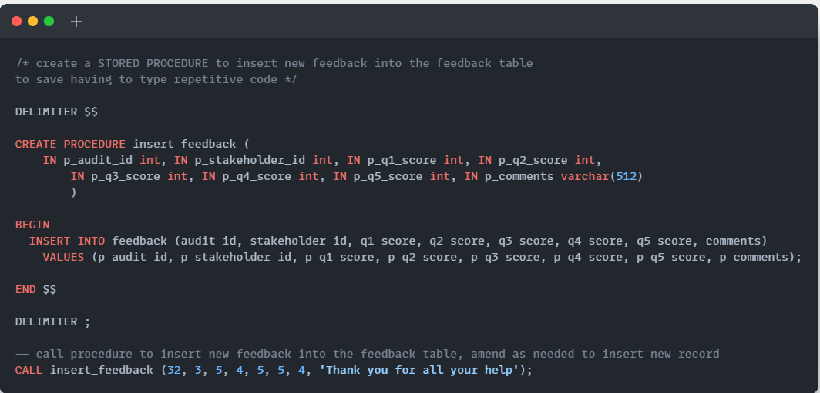
Creating a STORED PROCEDURE to make it easier to record a new feedback response

Slide 10
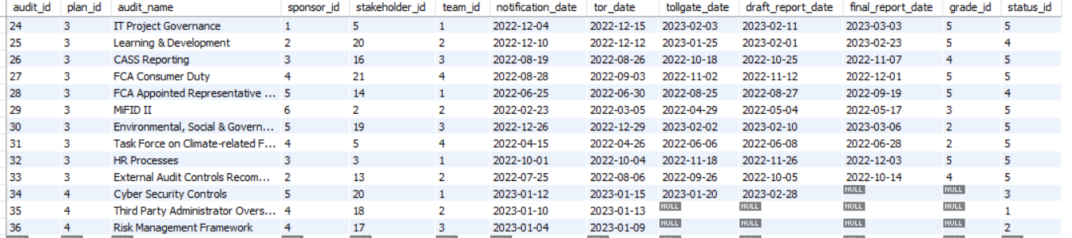

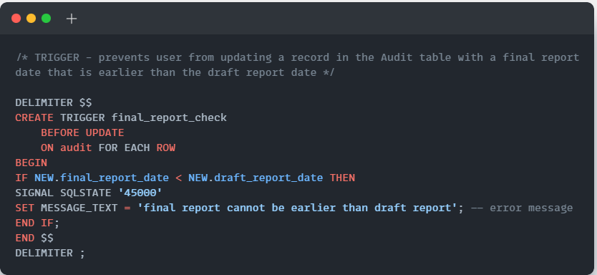
Creating a TRIGGER to prevent a final report date being entered that’s earlier than the draft report date

Slide 11
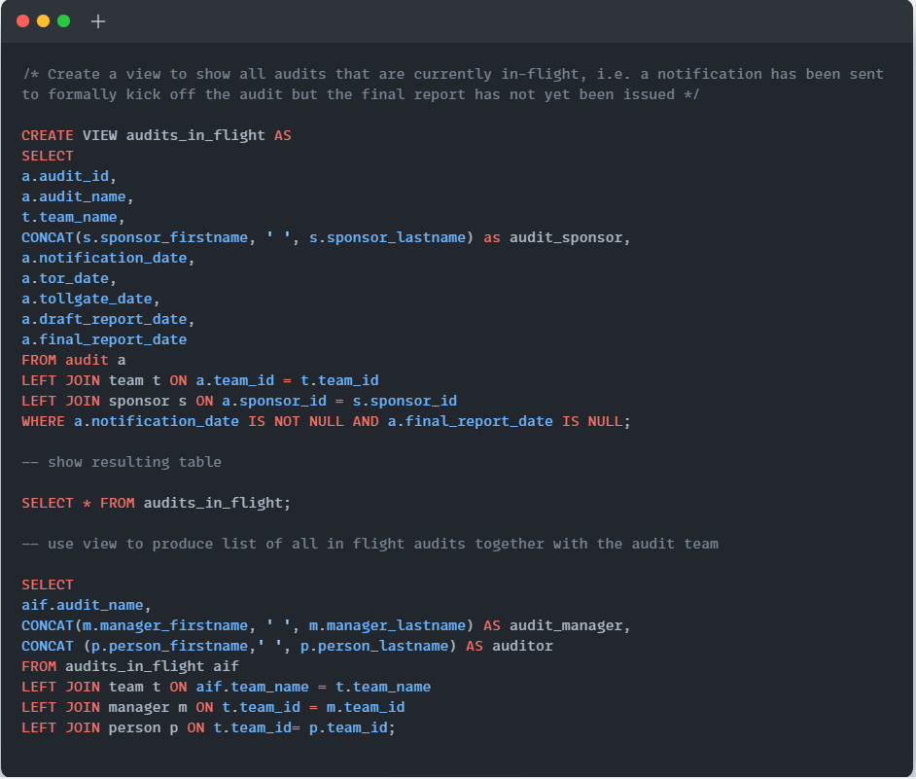
Creating a VIEW showing all in-flight audits
with their team, sponsor and milestones

Slide 12
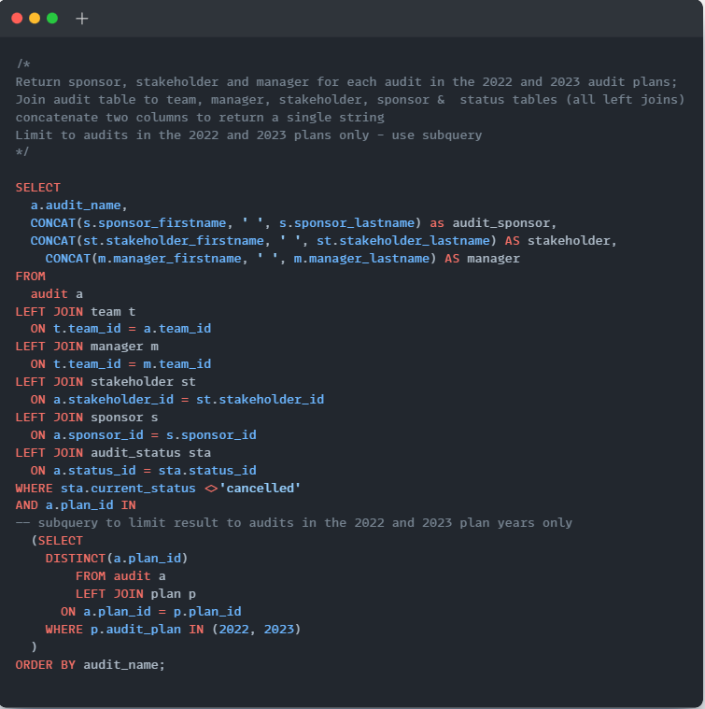
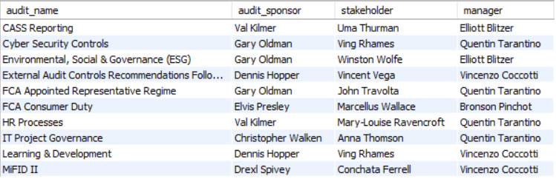
Query to produce a list of all audits on the 2022 and
2023 plans including the key people involved
Demonstrates the use of a SUBQUERY, CONCATENATING STRINGS, and lots of JOINS!

Slide 13
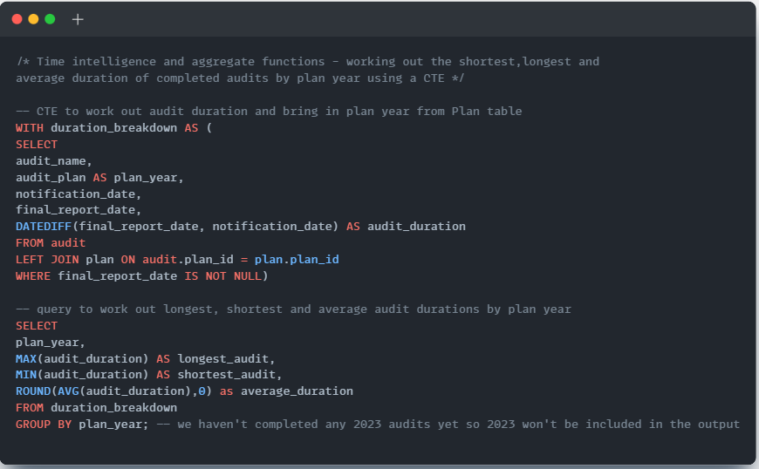
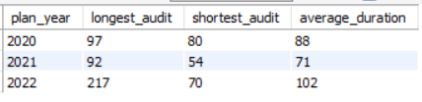
Analysis of audit duration broken down by plan year
Demonstrates use of CTEs, TIME INTELLIGENCE (DATEDIFF) and AGGREGATE functions (MAX, MIN, AVG) and ROUNDING

Slide 14
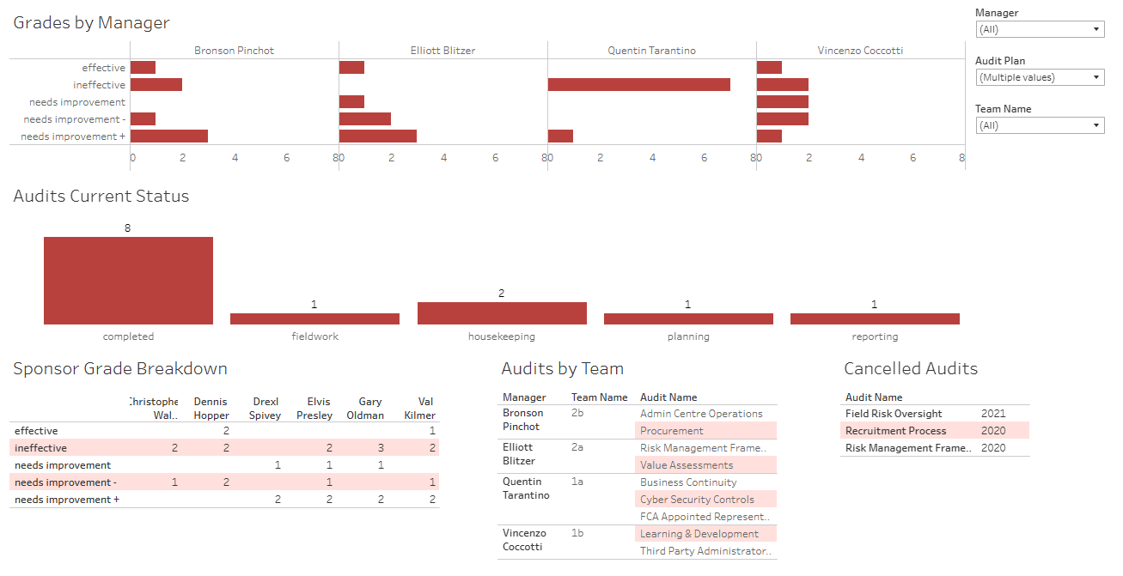
VISUALISATION IN TABLEAU
Click to view live dashboard: audit plan project | Tableau Public

Slide 15
THANK YOU!

